Slide 1
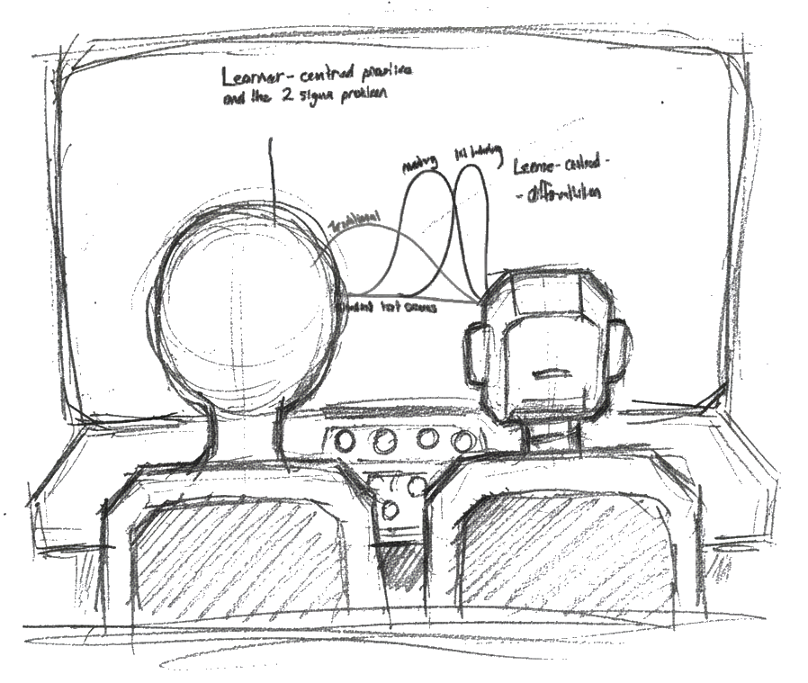
Teaching with AI: From Passive Users to Critical Partners
An Innovative Assessment for a GenAI-Driven World Dr. Michael Borck
Drafting and ideation for these materials were supported by generative AI tools, Python scripts, Quarto, and standard image editors under human oversight. All content has been reviewed, edited and verified by the author.
AI Generated Image

Slide 2

The Context: An Industry in Motion
AI Generated Image

Slide 3
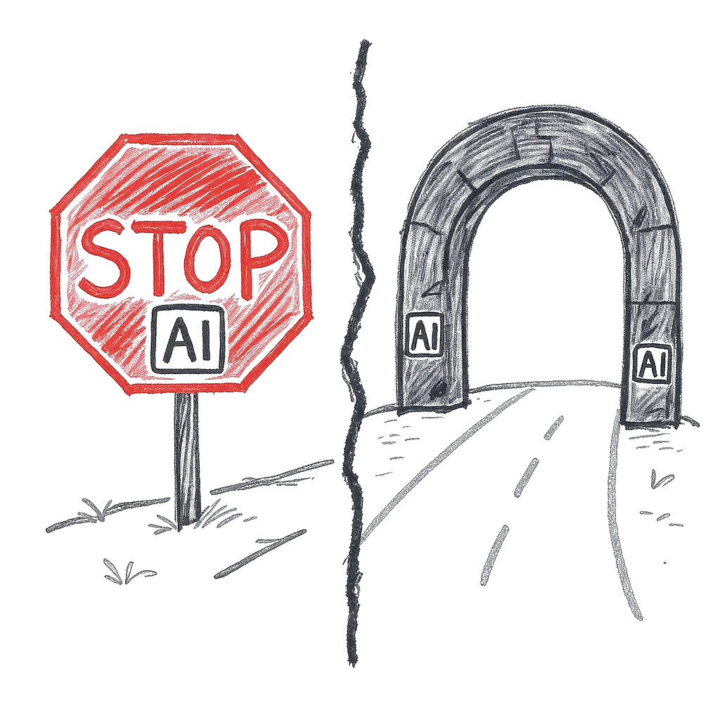
The Challenge: Assessing with AI
AI Generated Image

Slide 4
The Assessment: The ‘CloudCore’ Audit

Slide 5
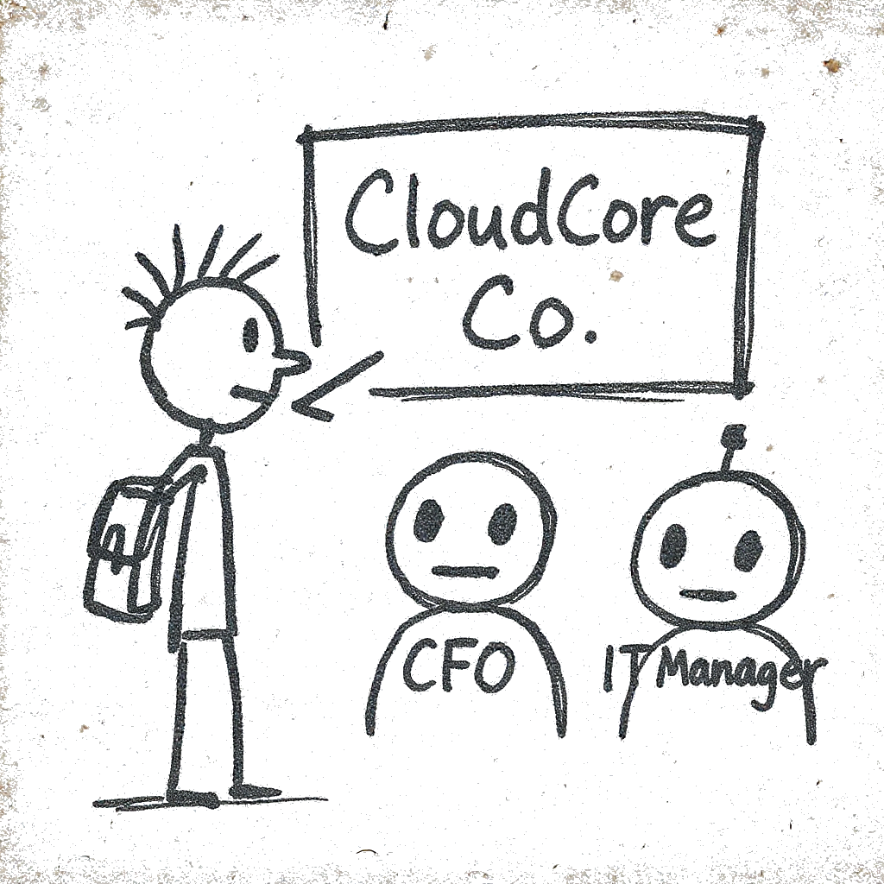
Innovation 1: AI as the “Client”
AI Generated Image

Slide 6
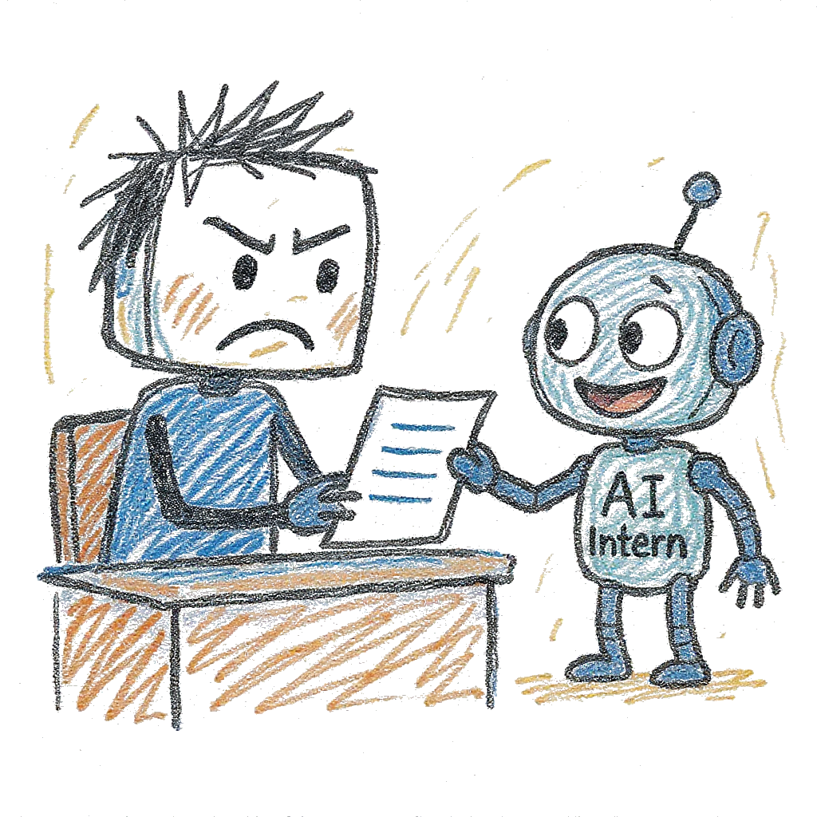
Innovation 2: AI as the “Intern”
AI Generated Image

Slide 7
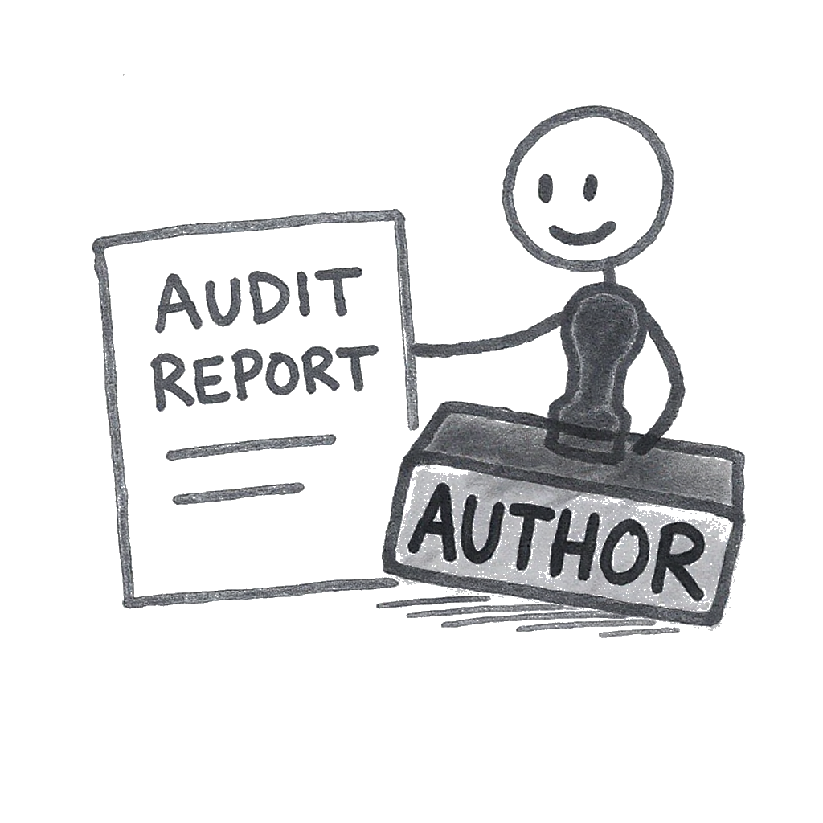
The Student as “Author”
AI Generated Image

Slide 8
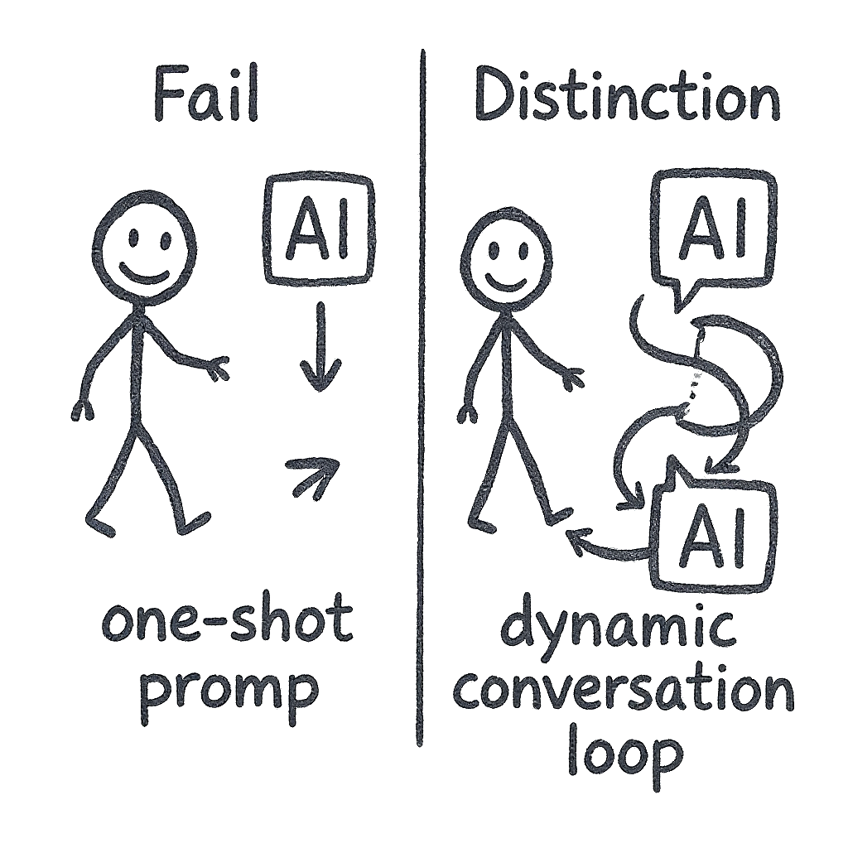
Pedagogy: “Thinking with AI”
AI Generated Image

Slide 9

Design & Authenticity
AI Generated Image

Slide 10
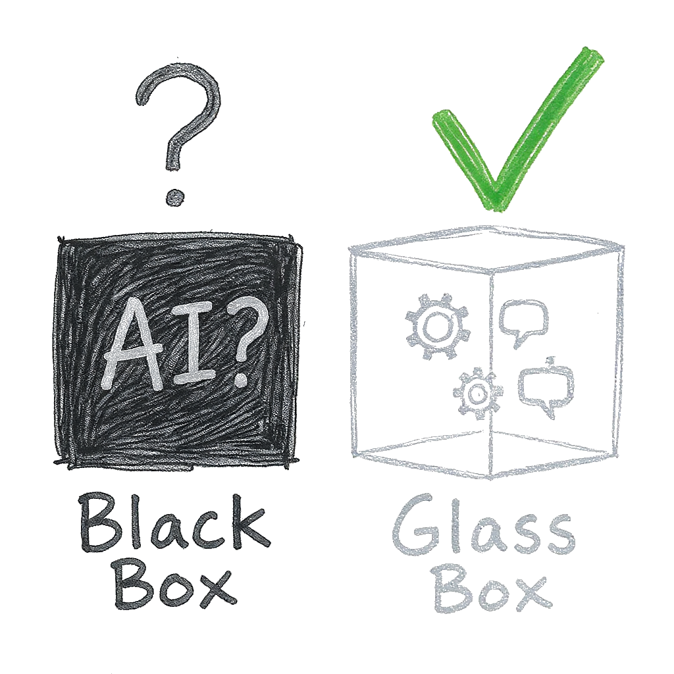
Academic Integrity as Transparency
AI Generated Image

Slide 11
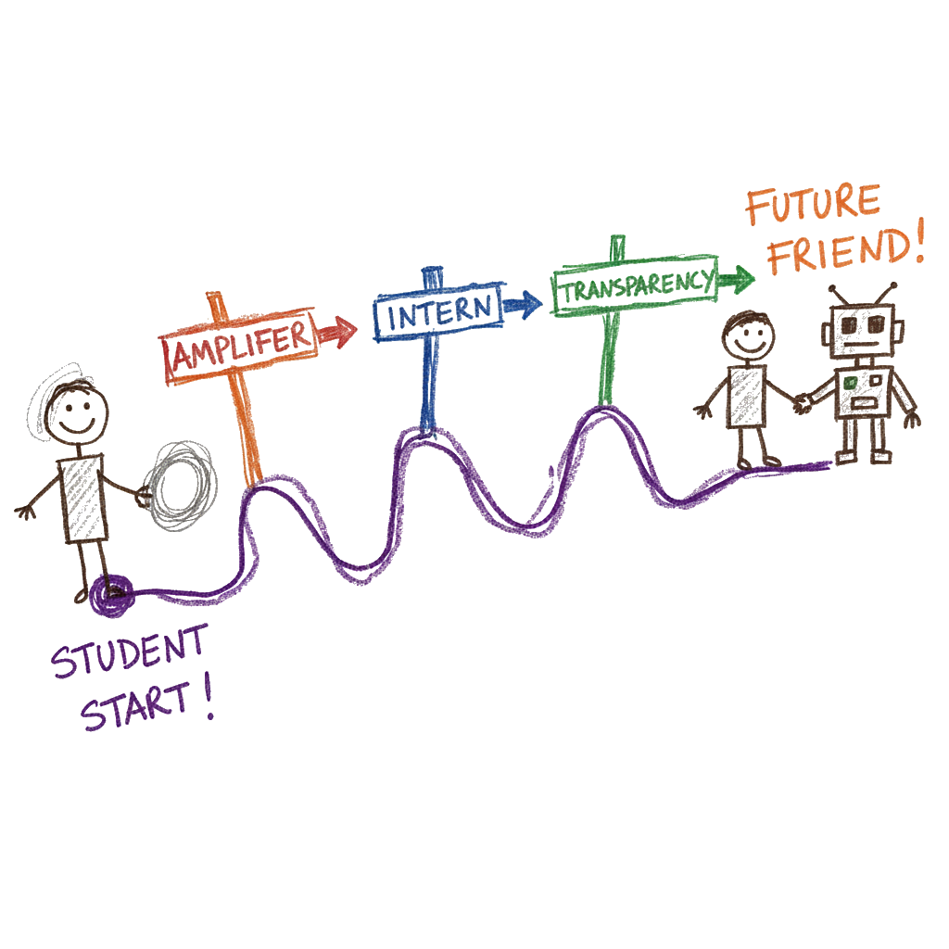
Key Takeaways
AI Generated Image

Slide 12

Thank You
Michael Borck michael.borck@curtin.edu.au
AI Generated Image

